Slide 1
Machine Learning Clustering Algorithms
Deepa D

Slide 2
Clustering Algorithm types
Kmeans Algorithm
Agglomerative Algorithm
Bisecting Kmeans Algorithm
Affinity Algorithm
Mean Shift Clustering Algorithm
Spectral Clustering Algorithm
DBSCAN Algorithm
HDBSCAN Algorithm
Optics Algorithm
Birch Algorithm

Slide 3
Kmeans Clustering
K Means is a data clustering approach for unsupervised clustering of data points into distinct groups.
It divides data into a predefined number of clusters
The elbow method is a technique that can be used to determine the optimal number of clusters to use in K-Means clustering.
K-means partitions a set of objects into K clusters in such a way that the sum of the squared distances between the objects and their assigned cluster mean is minimized.

Slide 4
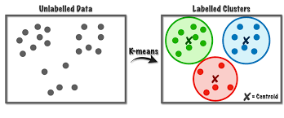
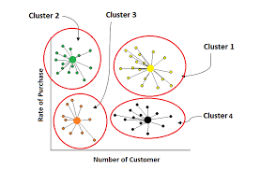
Kmeans Clustering

Slide 5
Kmeans Algorithm Pros and Cons
Pros:
Relatively simple to implement.
Less computationally expensive for large datasets
Requires prior knowledge of the number of clusters
Cons:
Limited to clusters of similar shapes and sizes.
Cannot handle noise and outliers well

Slide 6
Agglomerative Clustering
Agglomerative clustering works in a “bottom-up” manner
Each object is initially considered as a single-element cluster (leaf).
At each step of the algorithm, the two clusters that are the most similar are combined into a new bigger cluster (nodes).
This procedure is iterated until all points are member of just one single big cluster (root)
Calculating dissimilarities between objects is done by linkage and ward methods

Slide 7
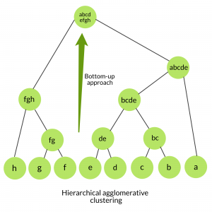
Agglomerative Clustering

Slide 8
Agglomerative Clustering
Pros:
No need for information about how many numbers of clusters are required.
Easy to use and implement
Cons:
Large storage requirements
Computationally intensive
Merging can’t be reversed

Slide 9
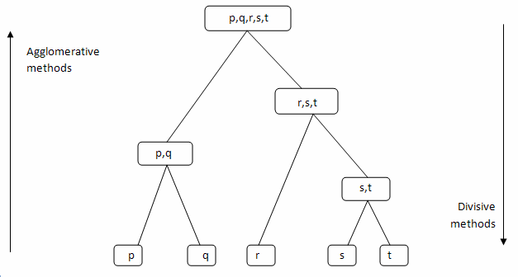
Bisecting Kmeans Algorithm
Bisecting K-Means Algorithm is a modification of K-Means Algorithm
It is a hybrid approach between a partitional and hierarchical clustering
Bisecting k-means algorithm splits one cluster into two sub clusters at each bisecting step (by using k-means) , further bisects the cluster that has high SSE until k clusters are obtained.

Slide 10
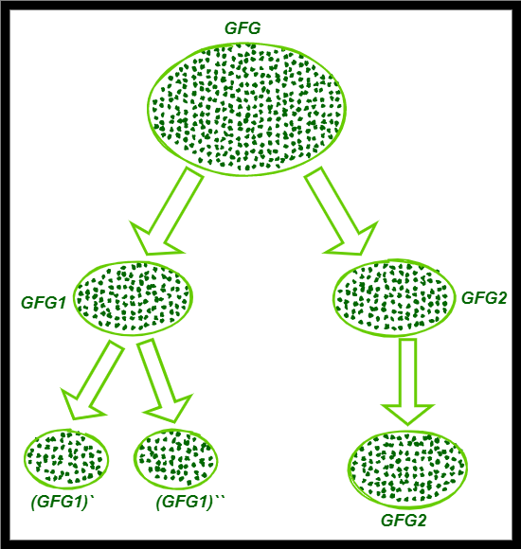
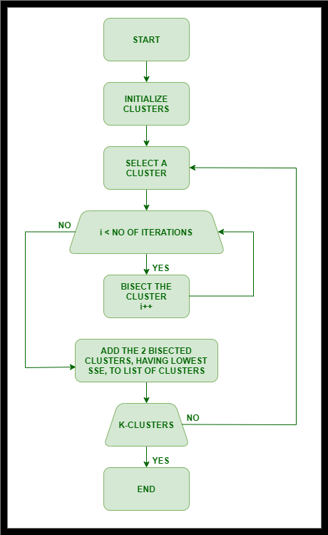
Bisecting Kmeans Algorithm

Slide 11
Bisecting Kmeans Algorithm
Pros:
Simplicity and Flexibility
Robustness to Noise
Cons:
Computationally Expensive
Fixed Binary Partition and cluster in balance
Dependency on k-means

Slide 12
Affinity Propagation Algorithm
The Affinity Propagation (AP) automatically determine the number of clusters (k) based on the data provided.
Message Passing: passing messages between data points to determine which points should be exemplars (cluster centers) for each other.
Exemplars and Clustering: Each data point can serve as an exemplar for other data points
Automatic Determination of k: It automatically determines the number of clusters based on the data
Iterations:It does this by iteratively exchanging messages between data points to find the most representative points.

Slide 13
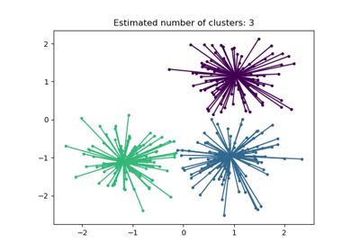
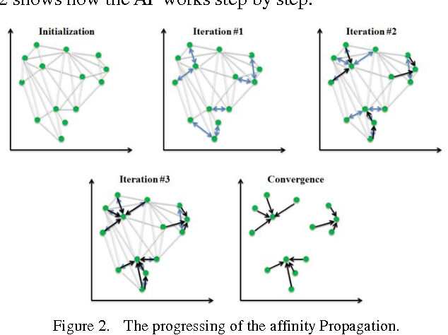
Affinity Propagation Algorithm

Slide 14
Affinity Propagation Algorithm
Pros:
No Need for Predefined k
Handles Non-convex Clusters
Doesn't Require Initial Guess of Cluster Centers
Robust to Noise
Cons:
Computational Complexity
Memory Intensive
Number of Clusters Determination

Slide 15
Mean Shift Clustering Algorithm
Mean Shift clustering is an unsupervised density based clustering the data points to the clusters iteratively by shifting points towards the mode(highest density point)
The algorithm iteratively performs these shifts until the points converge to a local maximum of the density function.
However, its computational complexity, sensitivity to parameters like bandwidth, and potential scaling issues should be considered when applying it to different datasets and scenarios.
Mean shift algorithm has applications in the field of image processing and computer vision.

Slide 16
Mean Shift Clustering Algorithm

Slide 17
Mean Shift Clustering Algorithm
Pros:
No Need for Number of Clusters
Adaptive to Cluster Shape
Automatic Bandwidth Selection
Cons:
Computational Complexity for large data sets
Sensitivity to Bandwidth
Memory Intensive
Not Suitable for High-dimensional Data

Slide 18
Spectral Clustering Algorithm
Spectral clustering is a powerful technique used for clustering data points based on the affinity (similarity) between them, often leveraging the eigenvalues and eigenvectors of a similarity matrix derived from the data.
Graph Representation: Spectral clustering treats the dataset as a graph, and groups similar data points
Eigenvalue Decomposition: This graph transforms the graph Laplacian matrix using eigenvalue decomposition, where clusters are more apparent.
Cluster Assignment: Clustering is performed using techniques like k-means on these eigenvectors or directly partitioning based on spectral properties.

Slide 19
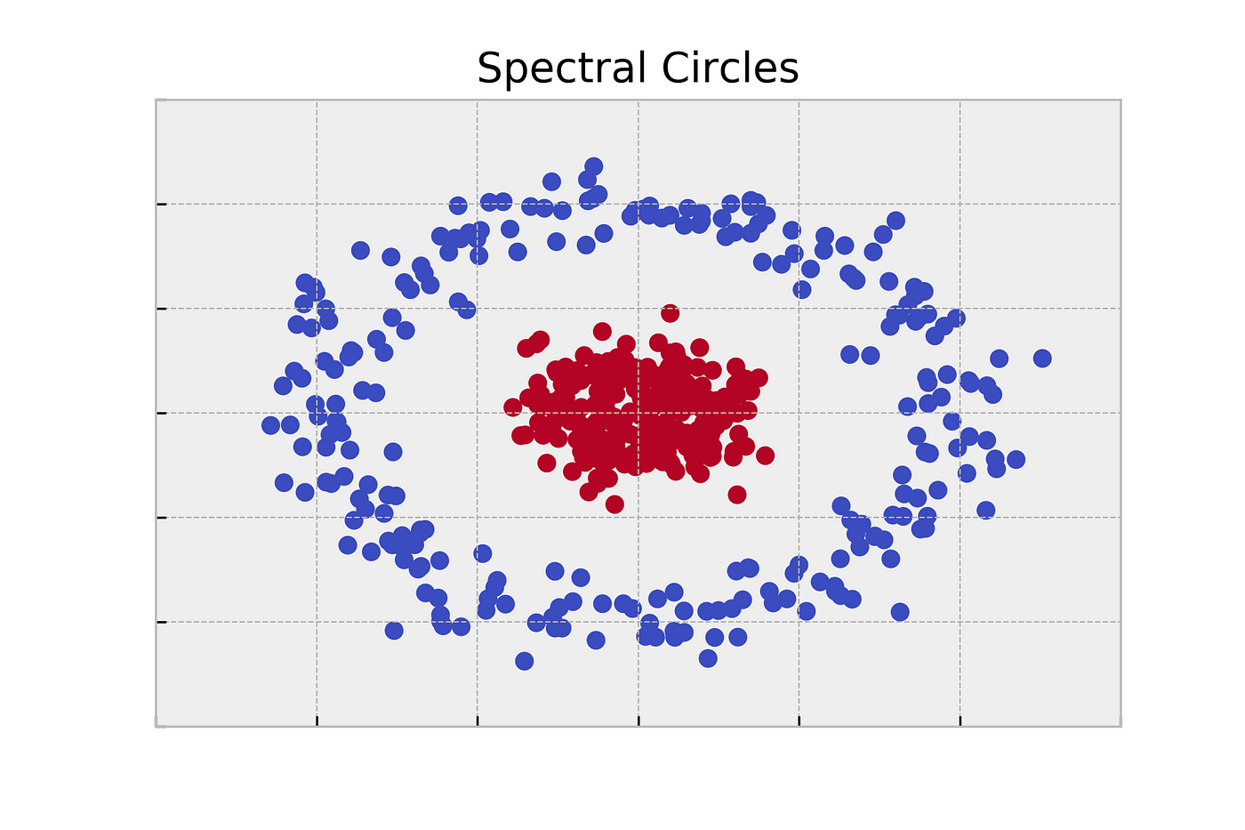
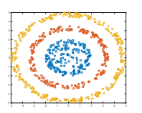
Spectral Clustering Algorithm

Slide 20
Spectral Clustering Algorithm
Pros:
Effective for Non-convex Clusters
Handles High-dimensional Data
Robust to Noise and Outliers
Produces High-Quality Clusters
Cons:
Parameter Sensitivity in constructing the similarity matrix
Computational Complexity
Menmory intensive to store similarity matrix for large datasets

Slide 21
DBSCAN Clustering Algorithm
Density-Based: DBSCAN clusters points based on their density within the dataset.
It defines clusters as dense regions of points separated by regions of lower density.
DBSCAN dynamically identifies the number of clusters based on the density of the data.
Core Points, Border Points, and Noise:
Core Points: Points that have at least a specified number of points (MinPts) within a specified distance (Eps) are considered core points.
Border Points: Points that are within Eps distance of a core point but do not meet the MinPts requirement themselves are considered border points.
Noise (Outliers): Points that are neither core points nor border points are classified as noise points or outliers.
It can identify clusters of arbitrary shapes and sizes, as long as they are separated by regions of lower density.
DBSCAN can effectively handle noisy data and outliers because noise points are not assigned to any cluster.

Slide 22
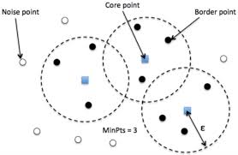
DBSCAN Clustering Algorithm

Slide 23
DBSCAN Clustering Algorithm
Pros:
Cluster Shape Flexibility
Robust to Noise
Automatic Cluster Detection
Efficient for Large Datasets
Cons:
DBSCAN performance can be sensitive to its two main parameters such as Eps (ε) and Minpts
Difficulty with Varying Density
Memory Intensive
Cluster Border Sensitivity

Slide 24
HDBSCAN Clustering Algorithm
HDBSCAN (Hierarchical Density-Based Spatial Clustering of Applications with Noise) is an extension of DBSCAN that provides a hierarchical clustering approach
It allows to identify clusters of varying densities and shapes and sizes in a dataset
It is used in scenarios where clusters have irregular densities
The algorithm works by building a hierarchy of clusters and then extracting
It is effective in discovering clusters in dataset with noise and varying densities
Main parameters are min samples and min cluster size
HDBSCAN extracts clusters from the MST by applying a condensed tree algorithm

Slide 25
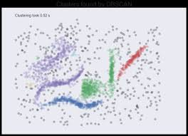
HDBSCAN Clustering Algorithm

Slide 26
HDBSCAN Clustering Algorithm
Pros:
Automatic Cluster Detection
Handles varying densities
Robust to Noise
Hierarchical Clustering
Cons:
Computational Complexity
Sensitive to Parameters
Memory Requirements
Scalability

Slide 27
Birch Clustering Algorithm
The BIRCH (Balanced Iterative Reducing and Clustering using Hierarchies) algorithm is a hierarchical clustering method designed for handling large-scale datasets efficiently.
Birch algorithm can cluster large datasets by first generating small and compact summary of the large dataset that retains as much information as possible. This smaller summary is then clustered instead of larger dataset called Clustering feature(CF)
CF entry is defined as an ordered triple(N,LS,SS)
N-No of data points in a cluster
LS-linear sum of data points
SS is the sum squared of data points in the cluster.
Parameters of BIRCH algorithm:
Threshold-max. no. of datapoints in a subcluster in the leaf node of CF Tree.
Branching factor:max. no of CF sub clusters in each internal node.
N_clusters:The number of clusters till the final clustering step.

Slide 28
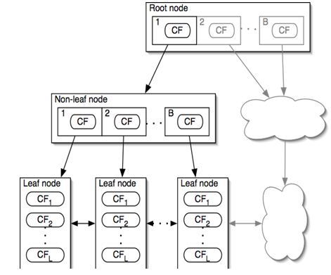
Birch Clustering Algorithm

Slide 29
Birch Clustering Algorithm
Pros:
Scalable and memory-efficient hierarchical clustering algorithm
Automatic cluster detection and hierarchical clustering capabilities
Handles Noise and Outliers
Produces High-Quality Clusters
Cons:
BIRCH's performance can degrade with high-dimensional data
It has three hyper-parameters (number of clusters, threshold, and branching factor), which makes using this algorithm effectively a bit tricky
Implementation and availability

Slide 30
OPTICS Clustering Algorithm
OPTICS (Ordering Points To Identify the Clustering Structure) is another hierarchical clustering algorithm, similar to HDBSCAN, but can extract clusters of various shapes and densities in large high dimensional datasets.
OPTICS extract clustering structure of a dataset by identifying the density- connected points.
The algorithm builds a density-based representation of the data by creating an ordered list of points called the reachability points.
Each point in the list is associated with a reachability distance which is a measure of how easy it is to reach that point from other points in the dataset.
Points with similar reachability distances are likely to be in the same cluster.

Slide 31
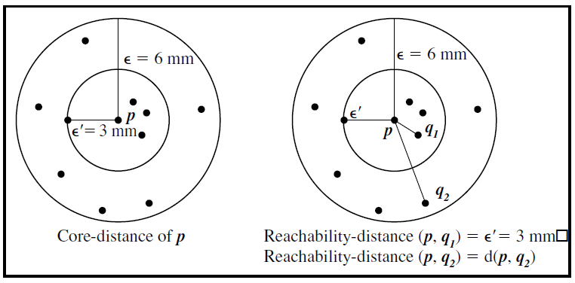
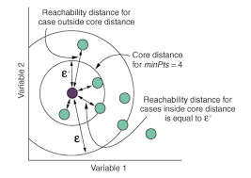
OPTICS Clustering Algorithm

Slide 32
OPTICS Clustering Algorithm
Pros:
Flexibility in Cluster Shape
Hierarchical Clustering Result
Interpretable Visualization by reachability plot
Robust to Noise and Outliers
Cons:
Computational Complexity for larger datasets
Parameter Sensitivity to min-points and distance metric used
Interpreting and extracting clusters from hierarchical structures can be challenging

